Slide 1
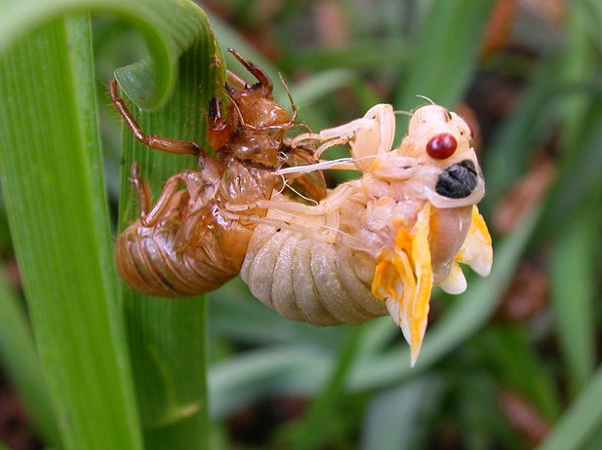
CLASSIFICATION OF ARTHROPODA

Slide 2
OVERVIEWS
Arthropoda is a much heterogenous group including a variety of animals with divergent views concerning their phylogeny.
Because of this reason , no definite system of classifying this phylum exists.
The classification adopted here is a synthesis of several views so that such a large and diverse phylum may be conveniently grouped.

Slide 3
Seven subphyla are recognised in the following classification.
Of these only Trilobitomorpha , Chelicerata and Mandibulata are definitely Arthropods.
Trilobitomorpha includes a number of extinct classes only .
Onychophora ,Tardigrada and Pentastomida show only doubtful or superficial relationships with other arthropods.

Slide 4
CLASSIFICATION
Sub phylum 1 :- Trilobitomorpha
Fossil trilobites .mostly marine and bottom –dwellers . Cambrian to permian.
Body 3 lobed, due to 2 longitudinal furrows.
Head distinct . Probably one pair of antennae.
Example :-Triarthrus ,Dalmanites

Slide 5
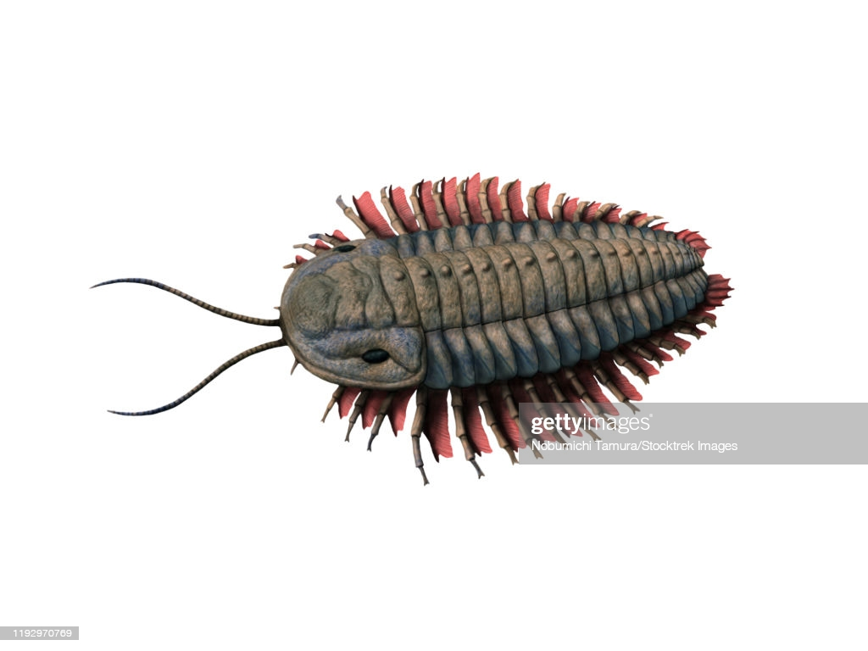

Slide 6
Sub –phylum 2:-CHELICERATA
Body divided into an anterior cephalothorax (prosoma ) and a posterior abdomen (opisthosoma).
Prosomatic appendages 6 pairs. First pair of preoral chelicerae with claws ,followed by postoral pedipalps and four pairs of walking legs.
Antennae and true jaws absent.
it has divided into two classes --

Slide 7
Class 1:-Merostomata
Marine with median simple and lateral compound eyes.
5 to 6 pairs of abdominal appendages with book gills.
Abdomen ending in a sharp telson or spine.
Excretion by coxal glands. No malpighian tubules.
Example :-Limulus(horseshoe or king crab),Eurypterus ,Pterygotus

Slide 8
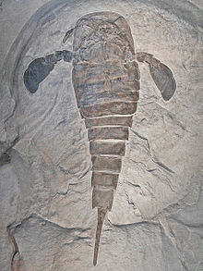
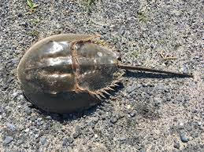

Slide 9
CLASS 2 :-Arachnida
a. Terrestrial or aquatic . Eyes simple, no compound eyes.
b. Cephalothorax (prosoma) with 2 chelicerae, 2 pedipalps and 4 pairs of walking legs.
c. Abdomen generally without appendages .
d. Respiration by tracheae ,book lungs or both .
e. Excretion by coxal glands and malpighian tubules .
f.Dioecious . Mostly oviparous courtship before mating.

Slide 10
Example :- Buthus,Palamnaeus,Androctonus,Centruroide,Chelifer, microcreagris, Lycosa ,Agelena, Latrodectus ,Galeodes,Koenenia,Mastigoproctus ,Thelyphonus, Charinus ,Cryptocellus,Phalangium,Sarcoptes etc.

Slide 11
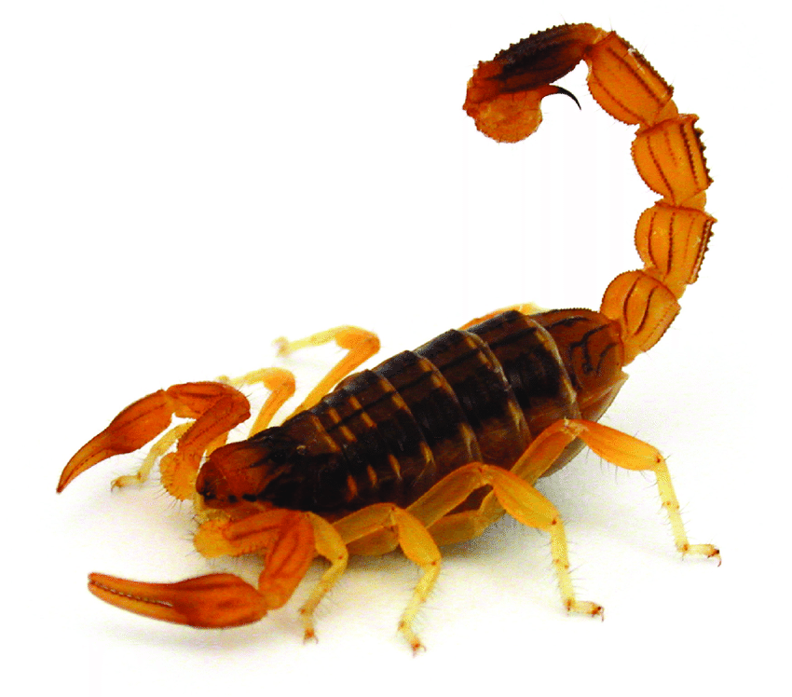

Slide 12
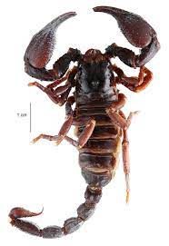

Slide 13
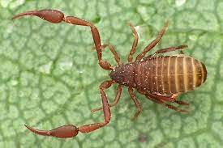

Slide 14
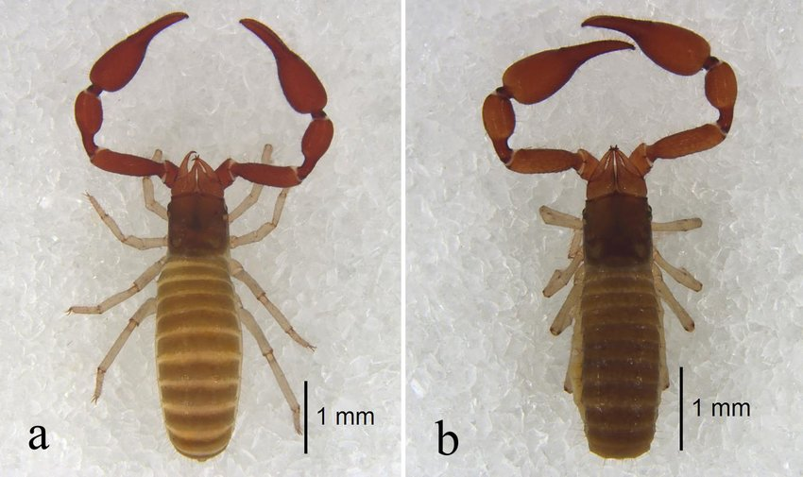

Slide 15
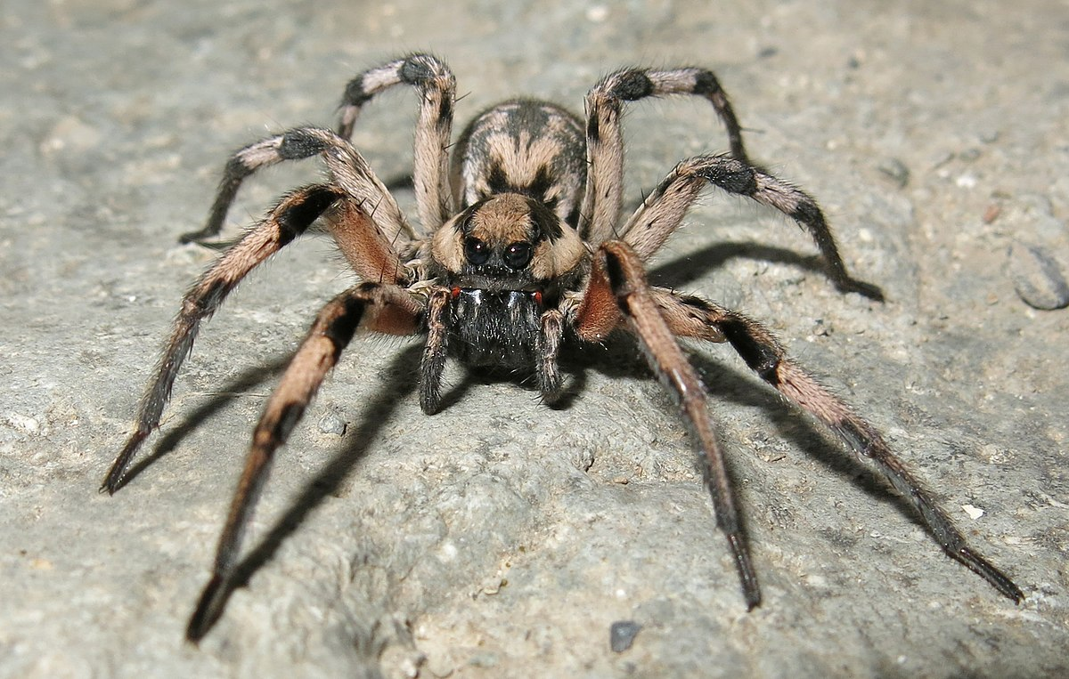

Slide 16
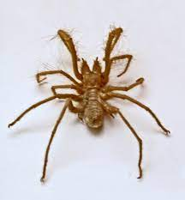

Slide 17
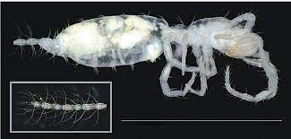

Slide 18
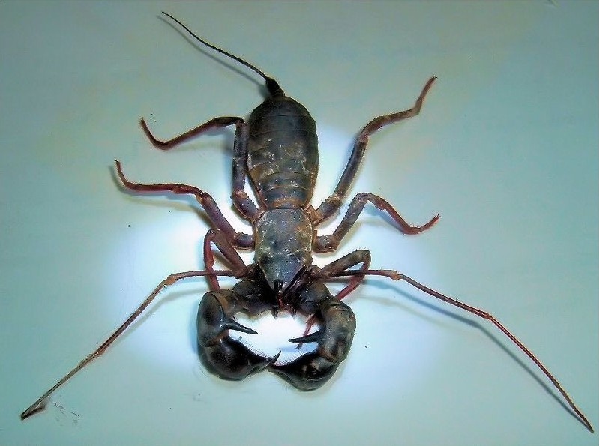

Slide 19
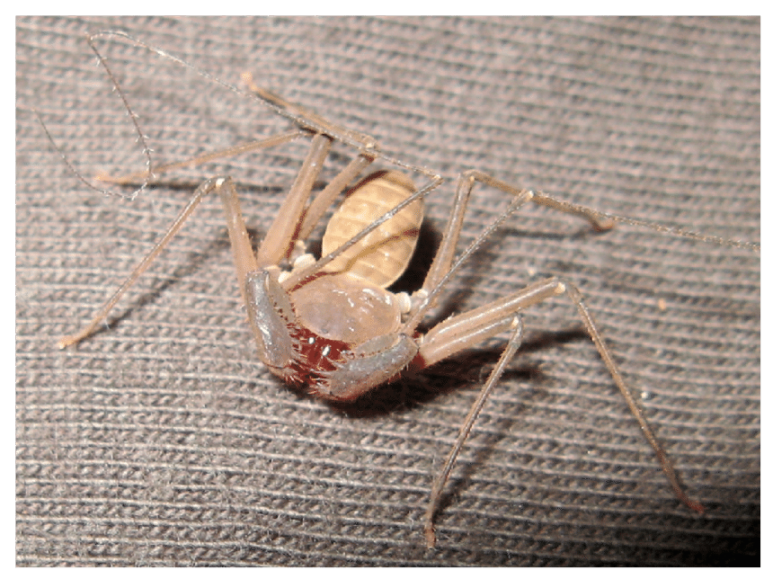

Slide 20
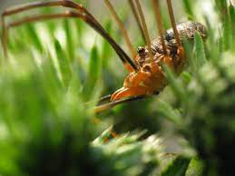

Slide 21
