Slide 1
GLOBAL ENVIRONMENTAL PROBLEMS unit: 5
Prepared by
ANINDITA CHAKRAVARTY

Slide 2
Major Problems
GLOBAL WARMING
OZONE LAYER DEPLETION
LOSS OF BIO-DIVERSITY
Let us discuss them one by one

Slide 3
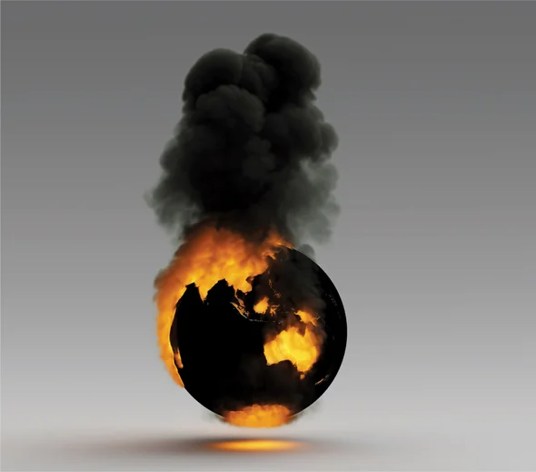
GLOBAL WARMING
Global warming is the long-term heating of Earth's climate system observed since the pre-industrial period (between 1850 and 1900) due to human activities, primarily fossil fuel burning, which increases heat-trapping greenhouse gas levels in Earth's atmosphere.
Heat is energy and when you add energy to
any system changes occur.
Because all systems in the global climate system
are connected, adding heat energy causes the
global climate as a whole to change.

Slide 4
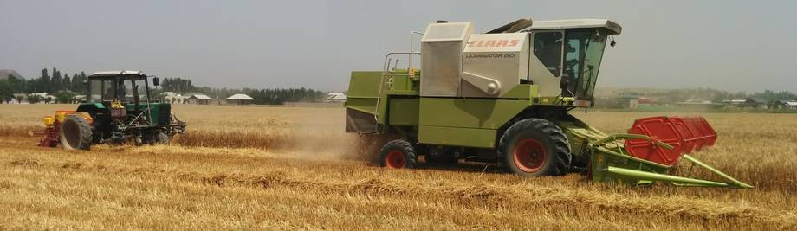
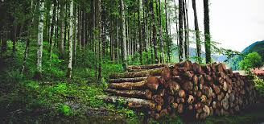
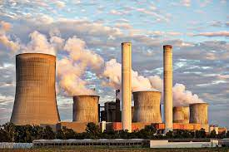
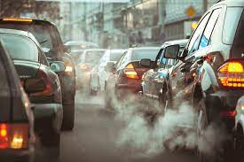
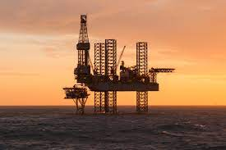
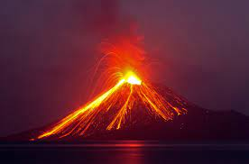
Causes of Global Warming
Power Plants: hydroelectric power, nuclear power
Transportation
Farming
Deforestation
Fertilizers
Oil drilling
Natural Causes: Forest fire, volcanic eruptions

Slide 5
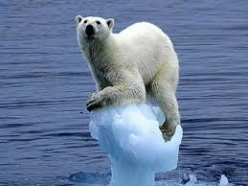

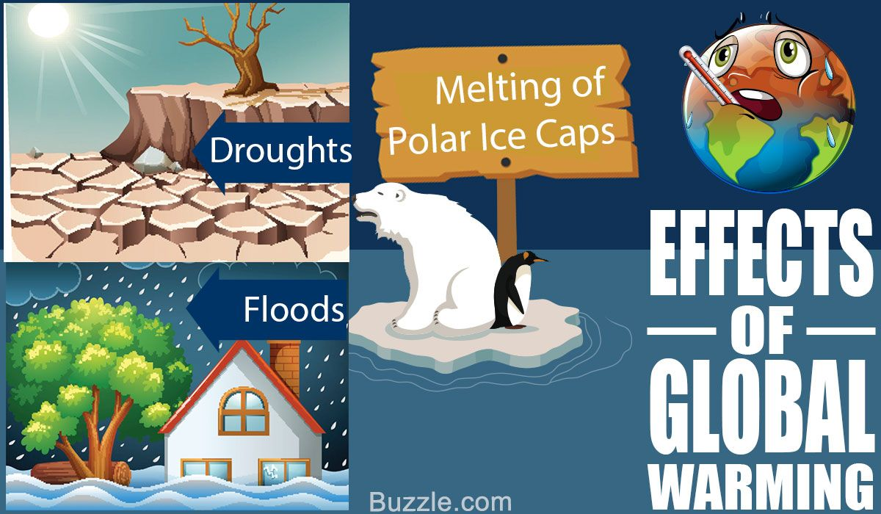
EFFECTS OF GLOBAL WARMING
Melting of Glaciers
Rise in droughts
Diseases
Hurricanes
Rise in sea level
Effects on Agriculture
Disruptions of food chain
Health risk
Animal Extinction
Economic collapse
Poor Air Quality
Human Extinction

Slide 6
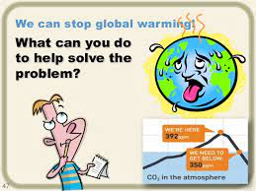
Reduce waste
Turn of electronic devices
Use clean fuel
Save energy
Plant a tree
Plant a vegetable garden
Conserve water
Spread awareness
Drive less
Recycling

Slide 7

Thank you

